Slide 1
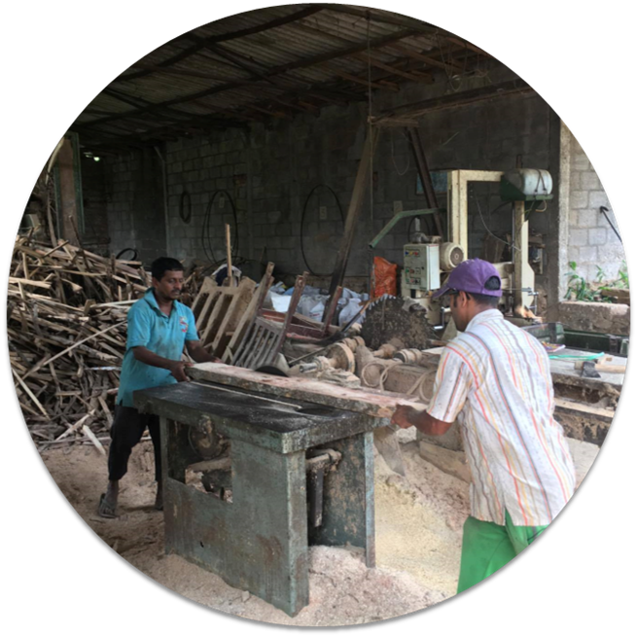
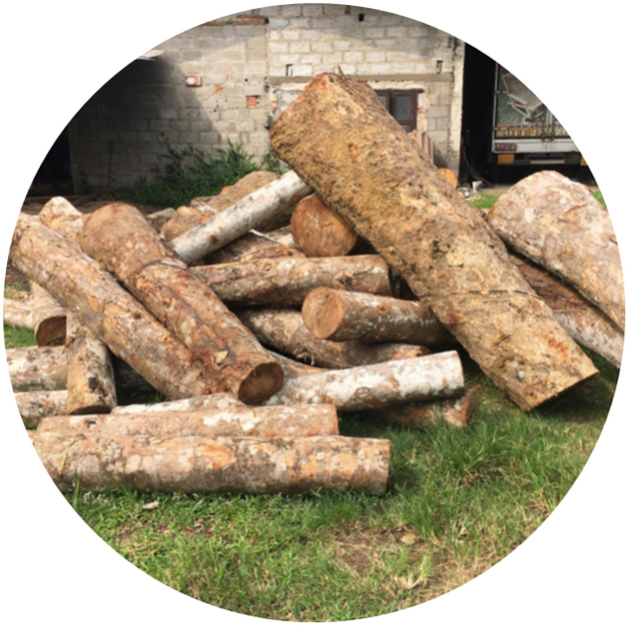
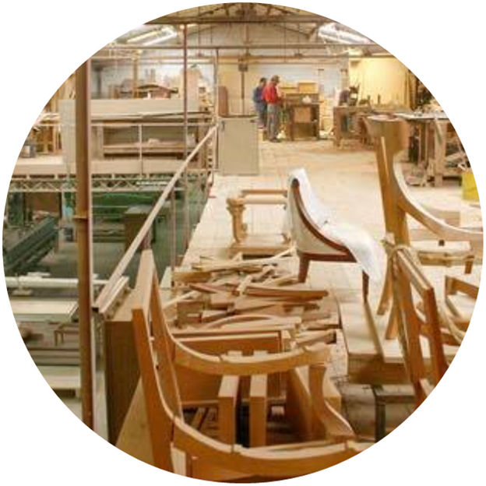
Chemwood (Pvt) Ltd.

Slide 2
Chemwood (Pvt) Ltd.
Private Limited Company.
Supplies
Manpower.
Wood Item.
Machinery.
Projects.
Dining furniture.
Restaurant furniture.
Baby furniture.
Outdoor furniture.
Bedroom furniture.
Gift items.

Slide 3











Product Manufacturing Process
Purchase of wood
Wood comes to
Wood
(
)
Timber Market
factory
seasoning
Wood comes at
Wood comes to
Furniture
sharper
machine
designing on
machine
CAD
Carpenters
Furniture comes
Carpenters
shape wood into
to molding
assembled the
furniture’s parts
machine
furniture
Furniture comes
Grind the
Furniture store
to inspection
furniture and
at store
before finishing
paint and polish

Slide 4
Group Number
We are....
03
Group Members
KARUNARATHNE T.N. (MS)
KKUMARASIRI P.A.H.D. (MS)
DABARE P.R.D. (MR)
WIMALASENA K.C.G (MR)
LAKSHAN K.A.R. (MR)
HEWAWITHARANA H.V.S.M. (MR)

Slide 5
Scope of Process that selected to design Database is,
Maintaining Employee Record.
Eliminate the main drawbacks.
Identified the benefits of current system.

Slide 6
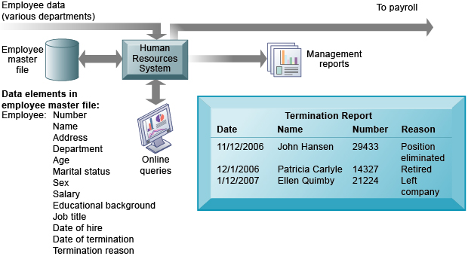

Why selecting the above Process ?
Still the Employee record is going on a manual system.
Not Computerized.
Waste of time.
Lack of reliability.
Lack of efficiency.
Keeping written documents may cause loss of Employee data.
TO

Slide 7
ER Diagram

Slide 8
m Employee m Order
1 Payment m Order
1 Customer m Payment
1 Customer m Item
m Item m Order
m Order m Material
1 Material 1 Supplier
Made
Has
Do
Select
Has
Use
Supply

Slide 10
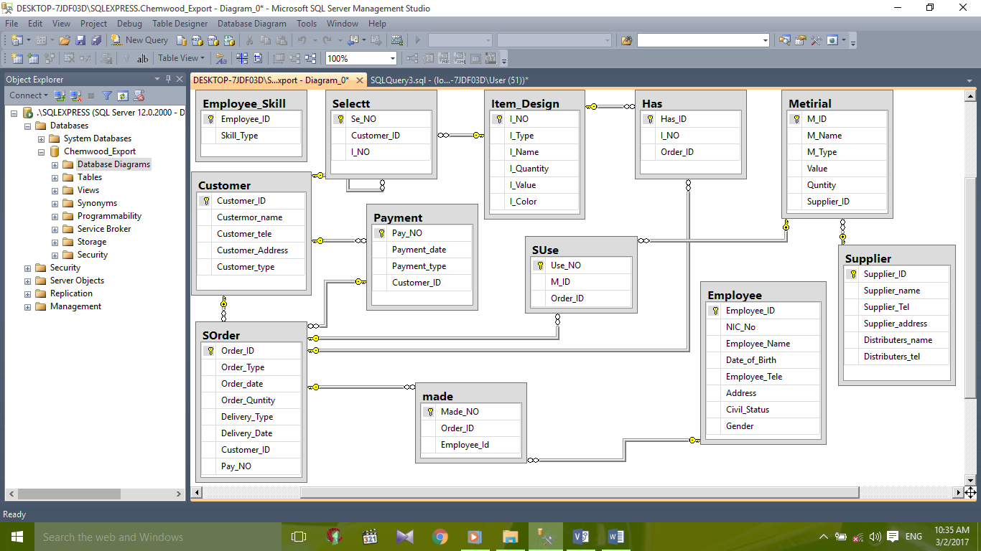
Database Model Diagrams

Slide 11


Normalization process
1 NF (1st Normal Form)
2 NF (2nd Normal Form)
3 NF (3rd Normal Form)

Slide 12


Tool we used to create & design Database

Slide 13
Queries
Creating the Database.
Creating the tables.
Inserting data to the database.

Slide 14
Thank You!

